Slide 1
Human Rights
Delaney Curran

Slide 2
Problems
What do human rights look like across the world
How does the United States compare to the rest of the world in human rights

Slide 3
The data
Our World in Data
World human rights distribution 1789-2021
United States human rights distribution 1790-2021
Variables:
Civil liberties: varieties of democracy
Civil liberties: high democracy
Civil liberties: low democracy
https://ourworldindata.org/grapher/distribution-human-rights-vdem?country=ARG~AUS~BWA~CHN~OWID_WRL~SVN

Slide 4
Summary statistics
 | Year | Varieties of democracy | High democracy | Low democracy
Min. | 1789 | 0.009 | 0.013 | 0.003
1st | 1870 | 0.204 | 0.245 | 0.154
Median | 1931 | 0.379 | 0.436 | 0.324
Mean | 1923 | 0.4393 | 0.4828 | 0.3947
3rd | 1977 | 0.65 | 0.707 | 0.597
Max. | 2021 | 0.978 | 0.991 | 0.972
 | Year | Varieties of democracy | High democracy | Low democracy
Min | 1790 | 0.5210 | 0.574 | 0.4770
1st | 1848 | 0.5660 | 0.615 | 0.5080
Median | 1906 | 0.7580 | 0.807 | 0.7145
Mean | 1906 | 0.7411 | 0.784 | 0.6992
3rd | 1963 | 0.8197 | 0.868 | 0.7845
Max | 2021 | 0.951 | 0.973 | 0.9380
World human rights distribution
United States human rights distribution
Range 0-1(most democratic)

Slide 5
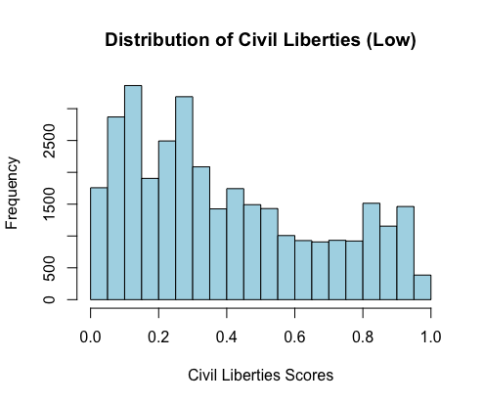
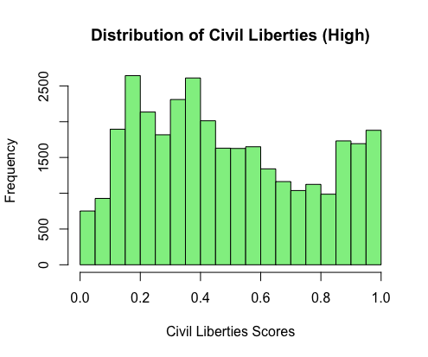
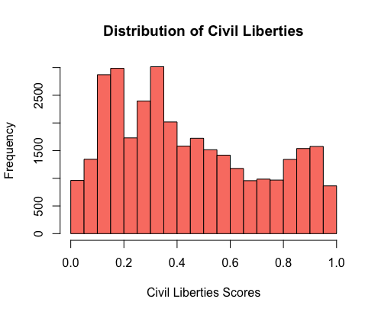
World human rights
Slightly positively skewed
Wide range of scores
Overall lower

Slide 6
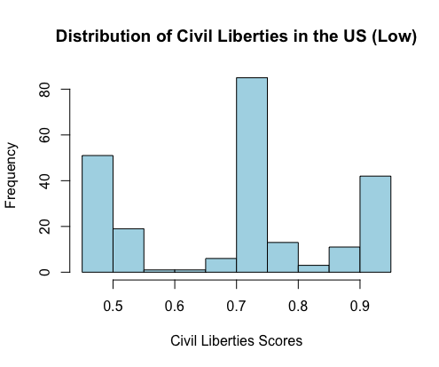
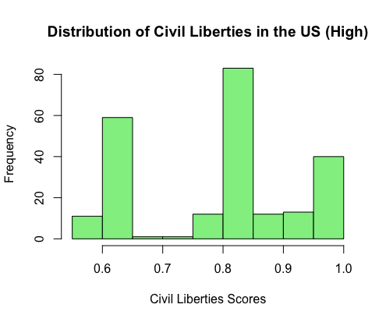
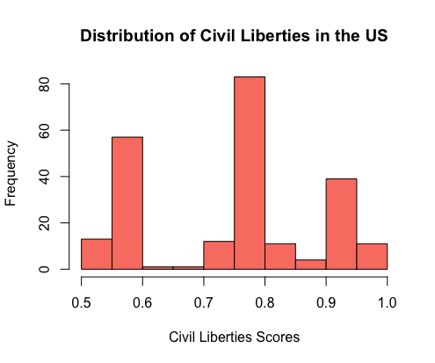
United states Human rights
Trimodal
Overall higher scores

Slide 7
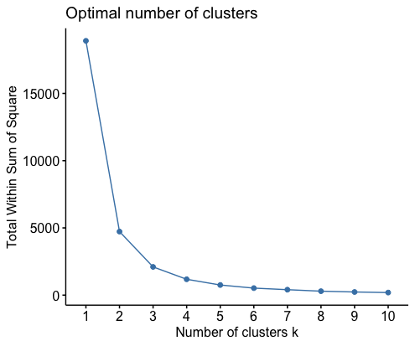
Optimal number of clusters

Slide 8
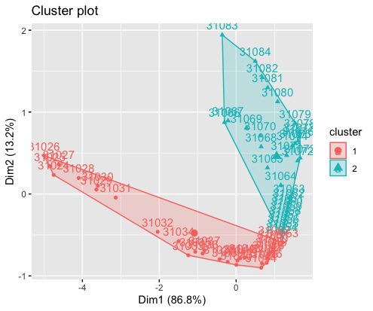
United states Cluster
1960-2021
2 main clusters
Cluster 1: 31
Cluster 2: 30

Slide 9
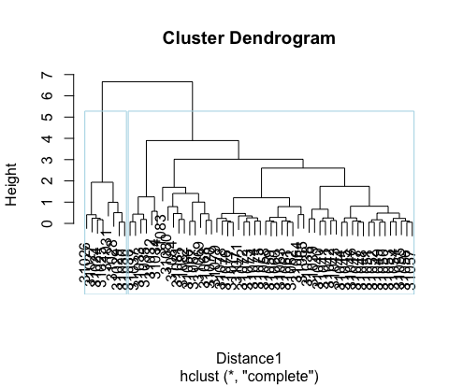

Slide 10
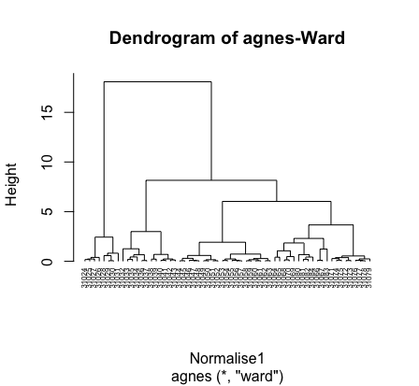

Slide 11
Conclusion
The United States has over all better civil liberties
Civil liberties get better as time progresses

